Slide 1


BE Project Presentation On Fake Instagram Profile Identification and Classification Using Machine Learning
Sinhgad Technical Education Society’s
NBN Sinhgad Technical Institutes Campus, Pune
Department of Information Technology
Presented By
Student Name Exam Seat No
1. Yashwant Ambre B191058504
2. Mayur Harne B191058546
3. Akshay Raykar B191058561
Guide
Prof. W. P. Rahane
Co-Guide
Prof. M. B. Satpute

Slide 2
Outline
Introduction
Motivation
Problem Statement
Literature Survey
Gap Analysis
Problem statement
Objectives
Social Impact
Applications
Flowchart
System Architecture
System Diagrams
Use case Diagrams
Feasibility and Scope
System Requirements
Project Timeline
Technical Risks
Any back up plan
Proposed Algorithm
Advantages & Limitations
Conclusion & Future Work
References

Slide 3
Introduction
With the increase in Internet usage, Instagram is now considered a very important platform for advertising marketing and social interaction. In recent years though Internet is a boon, online social networks are susceptible to threats by cyber criminals and spammers. Moreover, the popularity of social media users is determined by followers and hence users resort to different wrong means to promote increased profile followers. Researchers has offered a lot of feasible solutions for social media applications. In this paper, the automatic detection of fake profiles has been proposed to identify fake Instagram profiles so that the social life of Instagram users is secure.

Slide 4
Motivation
Instagram is one of the most popular social media platforms, and with its growing user base, the presence of fake profiles has become a significant concern. Fake profiles can be used for various malicious purposes, including spreading misinformation, phishing, or cyberbullying. This project aims to develop a machine learning model that can accurately identify and classify fake Instagram profiles.

Slide 5
Problem Statement
To develop a windows based model to identify and classify fake Instagram profile using machine learning algorithms such as Support Vector Machine and Random Forest algorithm.

Slide 6
Literature Survey
Sr. No. | Topic Name | Year | Author Name | Advantages | Disadvantages | Description
1 | Prediction of Fake Instagram Profiles using Machine Learning | 2023 | S. Saranya Shree, C. Subhiksha, R. Subhashimi | Reducing the number of fake profiles can lead to a more positive user experience on Instagram | Detecting fake profiles raises concerns about user privacy. | It is necessary to differentiate between genuine and fake accounts on social media based on the classification.
2 | Fake Accounts Detection on Social Media (Instagram and Twitter) | 2023 | Dr.P.V.Kumar, S.Shanti.Vardhan, Y.Kavya, K.Badri.Singh | Handle a massive number of profiles, which is crucial on a platform as large as Instagram. | It may lead to unfair or inaccurate profiling and potential discrimination. | The popularity of social media users is determined by followers and hence users resort to different wrong means to promote increased profile followers.

Slide 7
Literature Survey
Sr. No. | Topic Name | Year | Author Name | Advantages | Disadvantages | Description
3 | Fake Instagram Profile Identification and Classification using Machine Learning | 2021 | Preethi Harris, Anithra S, Gojal J | Handles both categorical and numerical data well. | May require tuning for optimal performance. | Instagram also has fake users. Some people do malicious activities using fake accounts such as impersonating artists or influencers, hate comments and spread rumors to become viral.
4 | Detection of Fake Accounts in Instagram using Machine Learning | 2021 | Ananya Deyl, Hamsashree Reddy, Manjistha Dey, Niharika Sinha | They encounter new types of fake accounts, they can learn to recognize . | Involve the analysis of user data, raising concerns about privacy and data security. | Most speculate that this is due to impact of social media such as Facebook, Instagram and Twitter on our daily lives.

Slide 8
Gap Analysis
Sr.No. | Existing System | Proposed System
1 | Train a machine learning model ( logistic regression, random forest, or neural networks) using these features. | Machine Learning model like SVM Support Vector Machine for image analysis and for text analysis, to capture complex patterns in both text and images.
2 | Collect data such as account creation date, activity, followers, posts, and comments from Instagram profiles. | Combine multiple machine learning models to create an ensemble model that leverages the strengths of different algorithms for improved accuracy.
3 | Instagram employs image recognition algorithms to spot profile pictures that may be stolen or generated by AI. | Design the system to be scalable to handle the large volume of data and profiles on Instagram.
4 | Instagram uses machine learning algorithms to detect fake profiles based on various factors such as the number of followers, likes, comments, and the activity history of the account. | The proposed system can employ deep learning models, such as Convolutional Neural Networks (CNNs), to improve the accuracy of image recognition.

Slide 9
Objectives
To implement a system that respects the privacy of users while still being able to analyze the content for safety concerns..
To identify phony profiles that have been shown to hurt more people than other online crimes. Therefore, it’s critical to spot a phony profile since the user is informed.
To protect users as phony users send spam messages or phishing links to users.
To protect real users from people with bad intentions, it’s important to find these fake identities.
To disseminate spam, information, and other false information.

Slide 10
Social Impact
Fake profiles are often used to spread misinformation and disinformation. Identifying and removing such profiles can help mitigate the spread of false information and maintain the integrity of online conversations.
Fake profiles can be used for cyberbullying, harassment, and other malicious activities. Detecting and taking action against these profiles can help create a safer online environment, especially for vulnerable users.
Businesses and influencers rely on Instagram for marketing and promotion. Identifying fake profiles that impersonate brands or individuals can protect the credibility of legitimate entities.

Slide 11
Application
Identify fake profiles that engage in spamming, harassment, or the dissemination of false information. Automatically flag or restrict the actions of these profiles to mitigate their impact on the community.
Detect fake profiles engaged in fraudulent activities such as scams, phishing, or impersonation. Promptly take action to prevent these profiles from victimizing other users.
Ensure that advertisements reach real and engaged audiences by excluding fake profiles from ad targeting. This can improve the return on investment for advertisers.
Refine user recommendation algorithms by considering the presence of fake profiles.

Slide 12
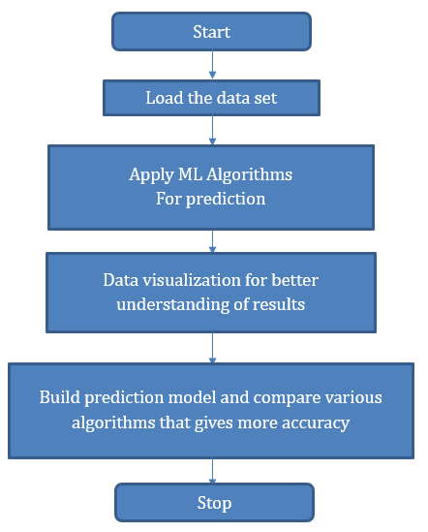
Flowchart

Slide 13
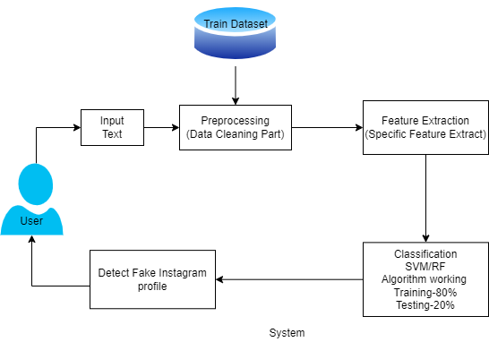
System Architecture

Slide 14
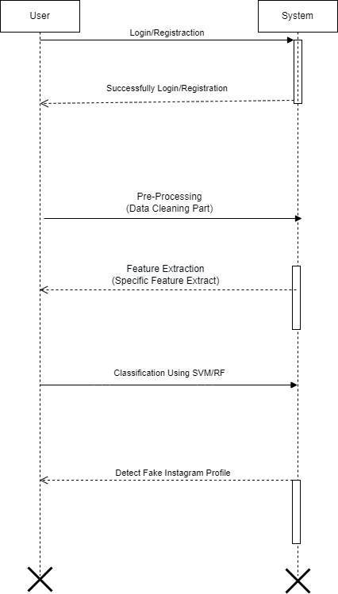
System Diagrams
Sequence:

Slide 15
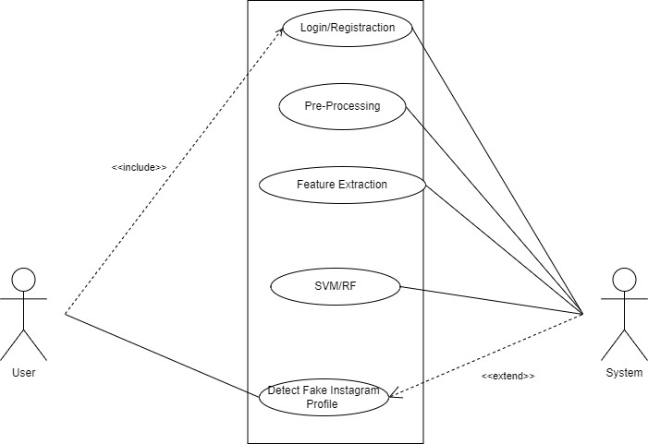
Use Case Diagrams
Use-Case:

Slide 16
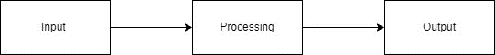
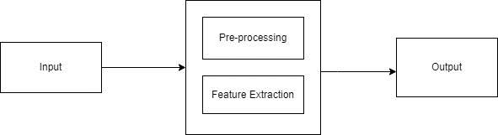
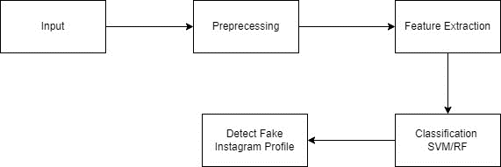
UML Diagram
DFD0:
DFD1:
DFD2:
Department of Information Tecchnology, NBNSTIC, Ambegaon(Bk), Pune
16

Slide 17
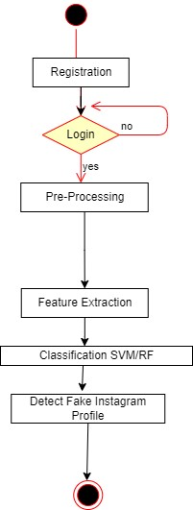
UML Diagram
Department of Information Tecchnology, NBNSTIC, Ambegaon(Bk), Pune
17

Slide 18
Feasibility & Scope
Fake profiles often exhibit certain characteristics that can be used for identification. These characteristics include limited or generic profile pictures, a small number of followers, a high number of followings, erratic posting patterns, and low engagement on posts.
Analyzing the content posted by a user can also provide insights. Fake profiles may frequently repost or share content from other accounts, use generic captions, or engage in behaviors like excessive use of hashtags.
Examining the user's behavior on the platform can be informative. Fake profiles may engage in activities such as mass following and unfollowing, liking and commenting on numerous posts in a short time, or sending unsolicited messages.

Slide 19
System Requirement
Software Requirements
Coding Language : Python
Operating System : Windows 10
Hardware Requirements
Processor : Pentium-IV
RAM :512 MB(min)
Hard Disk : 40 GB
Key Board : Standard Windows Keyboard

Slide 20
Technical Risk
Collecting and analyzing data related to Instagram profiles must be done in compliance with privacy laws and ethical guidelines.
Machine learning models used to detect fake profiles can exhibit bias, leading to misclassification or discrimination against certain groups. Ensuring fairness and reducing bias is crucial to avoid harming innocent users.
Striking the right balance is essential to avoid inconveniencing genuine users and to maintain the effectiveness of the system.

Slide 21
Any back up plan
If collecting a sufficient amount of labeled data is challenging, consider data augmentation techniques to create synthetic data that can help improve model performance.
Implement a mechanism for users to report suspicious profiles. Combine user reports with automated detection for more accurate results.
Create ensemble models by combining multiple machine learning algorithms to increase accuracy and robustness.
Work closely with legal teams and consider implementing stricter policies for account creation and verification.
Ensure that your model respects user privacy and ethical guidelines, especially when handling user data and profile information.

Slide 22
Proposed Algorithm
Support Vector Machines :
Support Vector Machines (SVMs) are a popular type of supervised machine learning algorithm used for classification and regression tasks. SVMs can perform both linear and non-linear classification.
Support Vector Machine Working Steps:
Step 1: Load the important libraries.
Step 2: Import dataset and extract the X variables and Y separately.
Step 3: Divide the dataset into train and test.
Step 4: Initializing the SVM classifier model.
Step 5: Fitting the SVM classifier model.
Step 6: Coming up with predictions.
Step 7:Evaluating model’s performance.

Slide 23
Proposed Algorithm
Random Forest:
Random Forest is an ensemble learning method that is widely used for both classification and regression tasks in machine learning. Random Forest is an ensemble learning technique that combines the predictions of multiple decision trees to improve the overall predictive accuracy and robustness.
Random Forest Working Steps:
Importing and processing the data.
Training the random forest classifier.
Testing the prediction accuracy.
Visualizing the results of the classifier.

Slide 24
SDLC Model
Planning Phase:
Define the project scope, objectives, and requirements.
Determine the types of fake profiles to be identified
Gather relevant data sources for training the machine learning model.
Design Phase:
Design the architecture of the machine learning model, including data preprocessing, feature extraction, model training, and evaluation components.
Define a data pipeline to handle data ingestion, cleaning, and transformation.
Implementation Phase:
Develop the machine learning model based on the defined architecture and algorithms.
Implement data preprocessing steps to handle missing values, outliers, and feature scaling.

Slide 25
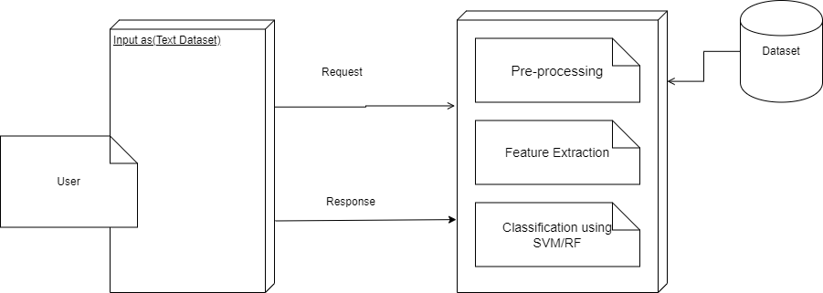
Deployment Diagram

Slide 26
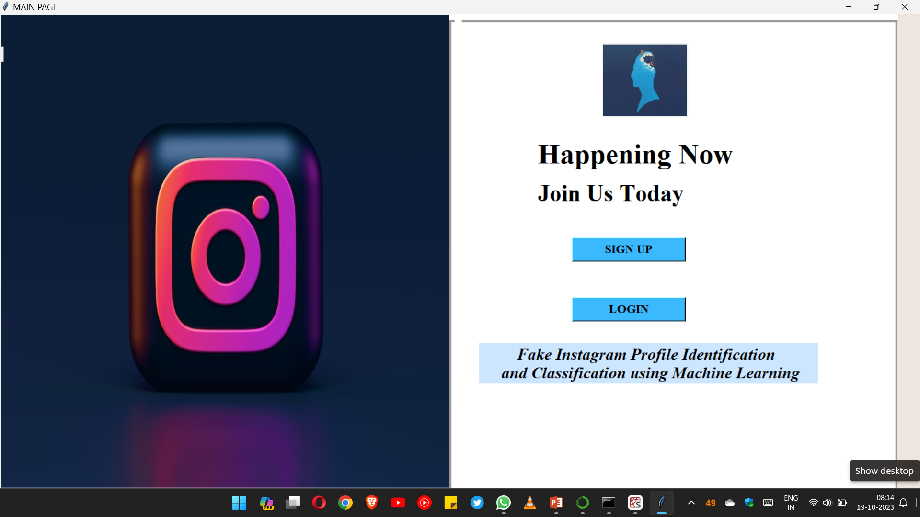
Screenshots of Project

Slide 27
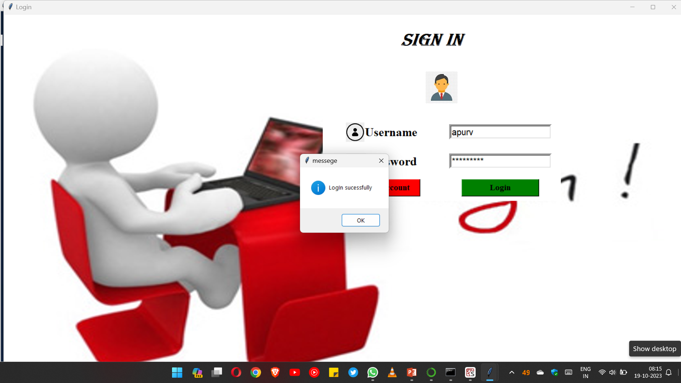

Slide 28
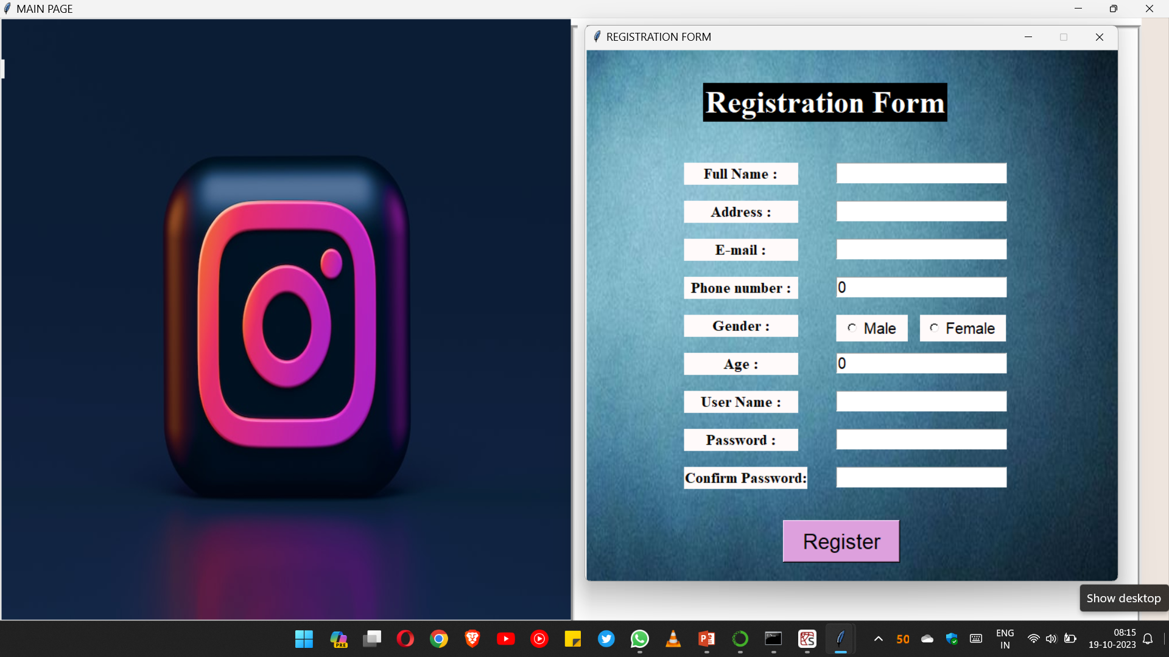

Slide 29
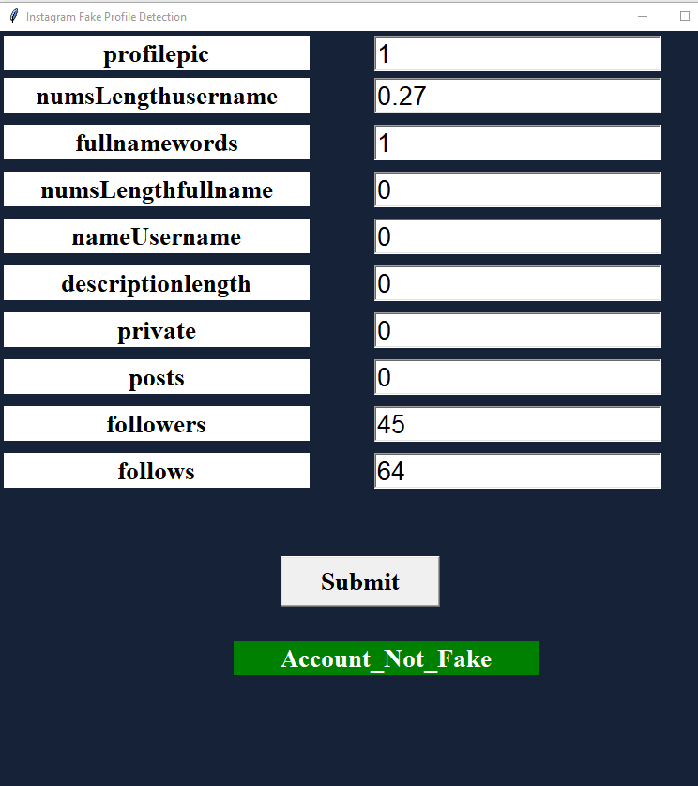

Slide 30
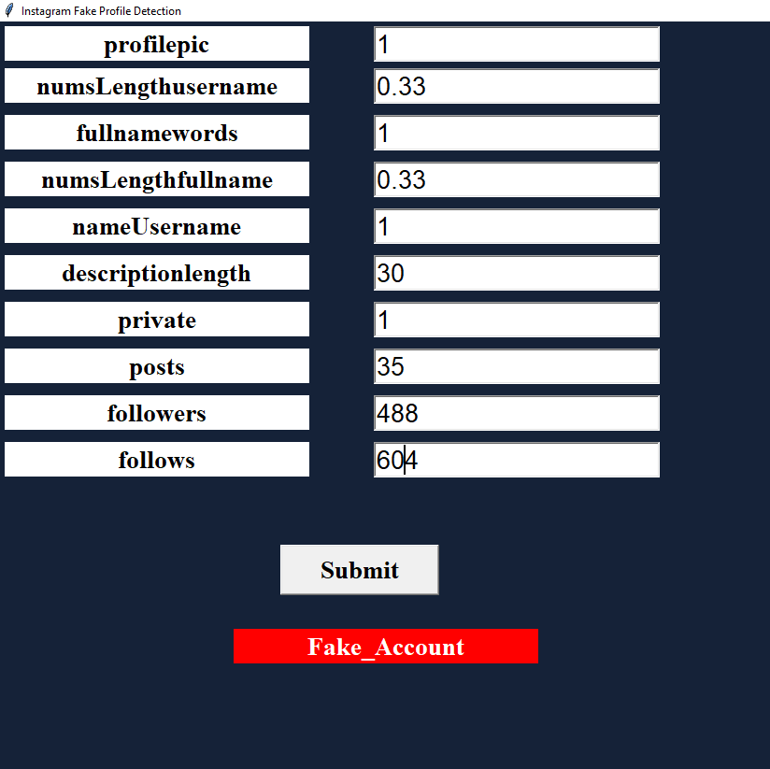

Slide 31
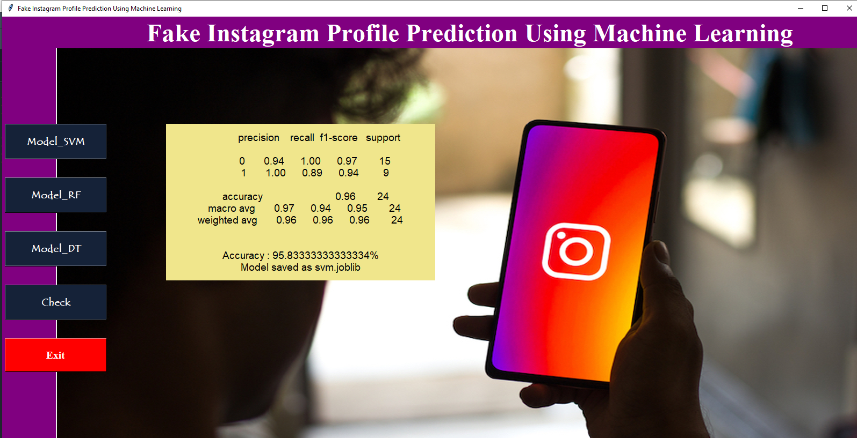

Slide 32
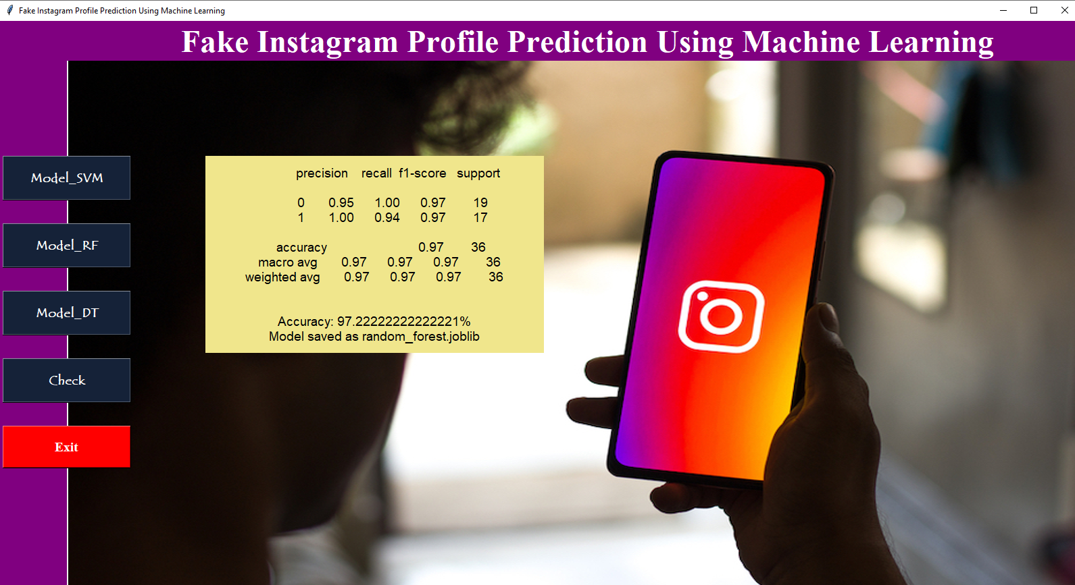

Slide 33
Advantages
Users can have a more positive and trustworthy experience on Instagram when fake profiles are identified and removed.
Fake profiles can be used for various malicious purposes, including harassment, spamming, and spreading misinformation.
Identifying and removing such profiles, Instagram can contribute to reducing the spread of misinformation on the platform.
Fake profiles can be used to impersonate legitimate users or organizations for phishing scams.
Social media algorithms often prioritize content and profiles based on user engagement.

Slide 34
Limitations
Malicious actors are continually evolving their tactics to create more sophisticated fake profiles that can evade detection algorithms.
Analyzing user profiles and behavior for the purpose of fake profile detection raises concerns about user privacy.
Real profiles significantly outnumber fake profiles on Instagram.
New types of fake profiles and malicious behavior emerge regularly, making it difficult for detection algorithms to keep up with evolving threats.
Some legitimate users may employ automation tools for benign purposes, such as social media management.
Smaller social media platforms or startups may lack the resources to develop and maintain robust fake profile detection systems.

Slide 35
Future Work
Explore more advanced machine learning techniques, such as deep learning models, to improve the accuracy of fake profile detection.
Focus on behavioral analysis, including user interaction patterns, posting frequency, and content quality, to identify anomalies indicative of fake profiles.
Implement real-time monitoring systems that can quickly adapt to emerging threats and adjust detection strategies accordingly.
Continuously evaluate detection models against adversarial attacks to ensure robustness against sophisticated fake profiles.
Create and maintain benchmark datasets that reflect the evolving landscape of fake profiles for researchers to evaluate and compare their detection methods.

Slide 36
Conclusion
The identification and classification of fake Instagram profiles are crucial endeavors with significant implications for user trust, safety, and the overall integrity of the platform. This multifaceted problem requires a holistic approach, involving data, machine learning models, ethical considerations, and user engagement. Detecting and classifying fake Instagram profiles is a complex challenge that involves various techniques, including natural language processing, image analysis, and social network analysis.

Slide 37
References
[1] Zainab Agha, Neeraj Chatlani, Afsaneh Razi, and Pamela Wisniewski. 2020. Towards conducting responsible research with teens and parents regarding online risks. In Extended Abstracts of the 2020 CHI Conference on Human Factors in Computing Systems. 1–8.
[2] Shiza Ali, Afsaneh Razi, Seunghyun Kim, Ashwaq Alsoubai, Joshua Gracie, Munmun De Choudhury, Pamela J Wisniewski, and Gianluca Stringhini. 2022. Understanding the Digital Lives of Youth: Analyzing Media Shared within Safe Versus Unsafe Private Conversations on Instagram. (2022), 1–14.
[3] Detect fake profiles on social media network https://telanganatoday.com/detect-fake-profiles-on-social-medianetworks
[4] S. M. Din, R. Ramli and A. A. Bakar, "A Review on Trust Factors Affecting purchase Intention on Instagram", 2018 IEEE Conference on Application Information and Network Security (AINS), 2018

Slide 38
References
[5]. S.C. Boerman, "The effects of the standardized Instagram disclosure for micro- and meso-influencers", Computers in Human Behavior, vol. 103, pp. 199-207, 2020.
[6]. S. Sheikhi, An Efficient Method for Detection of Fake Accounts on the Instagram Platform, 2020.
[7]. J. Kang and L. Wei, "Let me be at my funniest: Instagram users' motivations for using Finsta (a.k.a. fake Instagram)", The Social Science Journal, 2019.
[8]. M. Mondal, L. A. Silva and F. Benevenuto, "A Measurement Study of Hate Speech in Social Media", Proceedings of the 28th ACM Conference on Hypertext and Social Media - HT '17, 2017.
[9]. B. Mathew, R. Dutt, P. Goyal and A. Mukherjee, "Spread of Hate Speech in Online Social Media", Proceedings of the 10th ACM Conference on Web Science
[10] H. Hilal Bashir and S. A. Bhat, "Effects of Social Media on Mental Health: A Review", The International Journal of Indian Psychology, vol. 4, no. 3, 2017

